Slide 1
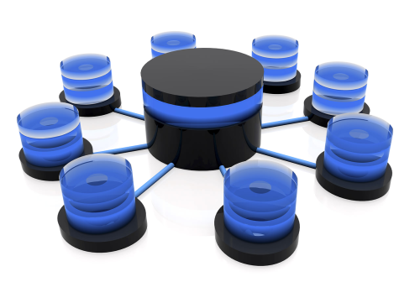
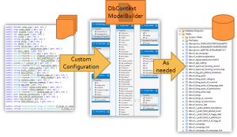
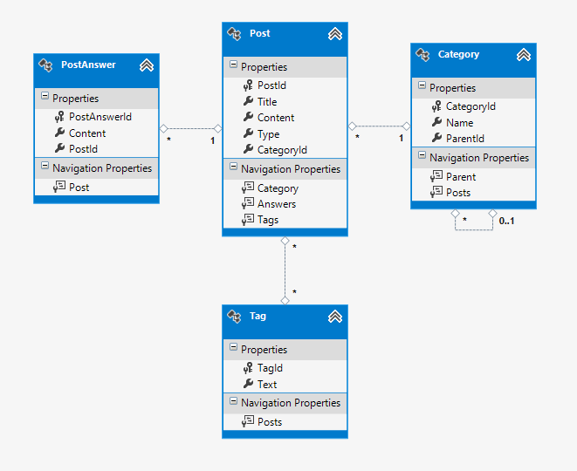
Entity Framework Code First
Ivaylo Kenov
Technical Trainer

Slide 2


Table of Contents
Entity Framework
Modeling Workflow
Code First Main Parts
Migrations & Mappings
CRUD on Data & LINQ Basics
Performance Issues
Attaching and Detaching Context Objects
Repository Pattern

Slide 3
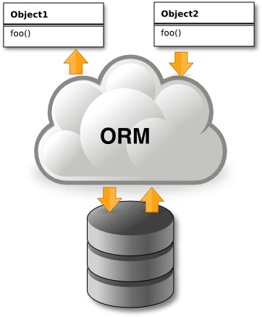
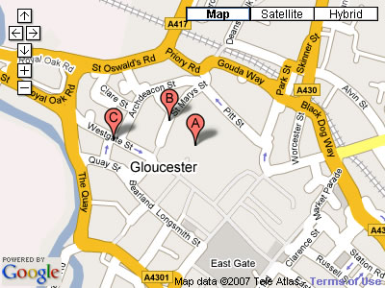


Introduction to ORM
Object-Relational Mapping (ORM) Technologies

Slide 4
ORM Technologies
Object-Relational Mapping (ORM) is a programming technique for automatic mapping and converting data
Between relational database tables and object-oriented classes and objects
ORM creates a "virtual object database"
Which can be used from within the programming language, e.g. C# or Java
ORM frameworks automate the ORM process
A.k.a. object-relational persistence frameworks

Slide 5
ORM Frameworks
ORM frameworks typically provide the following functionality:
Creating object model by database schema
Creating database schema by object model
Querying data by object-oriented API
Data manipulation operations
CRUD – create, retrieve, update, delete
ORM frameworks automatically generate SQL to perform the requested data operations

Slide 6
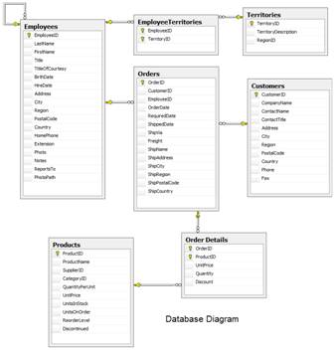
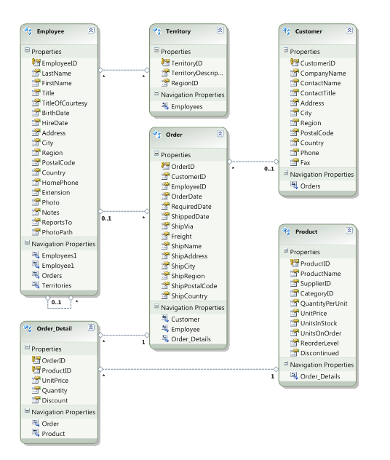




ORM Mapping – Example
Database and Entities mapping diagrams for a subset of a database
Relational database schema
ORM Entities (C# Classes)
ORM
Framework

Slide 7


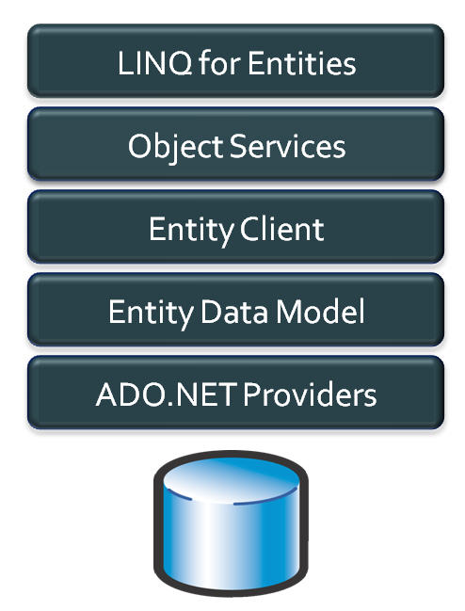
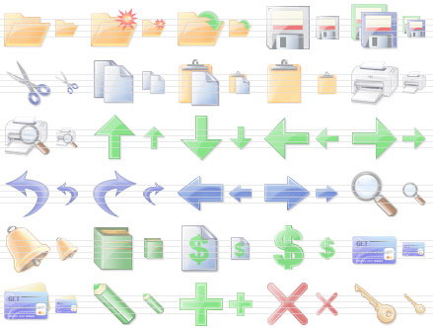
Entity Framework
Object Relation Persistence Framework

Slide 8
Overview of EF
Entity Framework (EF) is a standard ORM framework, part of .NET
Provides a run-time infrastructure for managing SQL-based database data as .NET objects
The relational database schema is mapped to an object model (classes and associations)
Visual Studio has built-in tools for generating Entity Framework SQL data mappings
Data mappings consist of C# classes and XML
A standard data manipulation API is provided

Slide 9
Entity Framework Features
Maps tables, views, stored procedures and functions as .NET objects
Provides LINQ-based data queries
Executed as SQL SELECTs on the database server (parameterized queries)
Built-in CRUD operations – Create/Read/Update/Delete
Creating or deleting the database schema
Tracks changes to in-memory objects

Slide 10
Entity Framework Features
Works with any relational database with valid Entity Framework provider
Work with a visual model, database or with your own classes
Has very good default behavior
Very flexible for more granular control
Open source: entityframework.codeplex.com
Not dependent on .NET release cycle

Slide 11
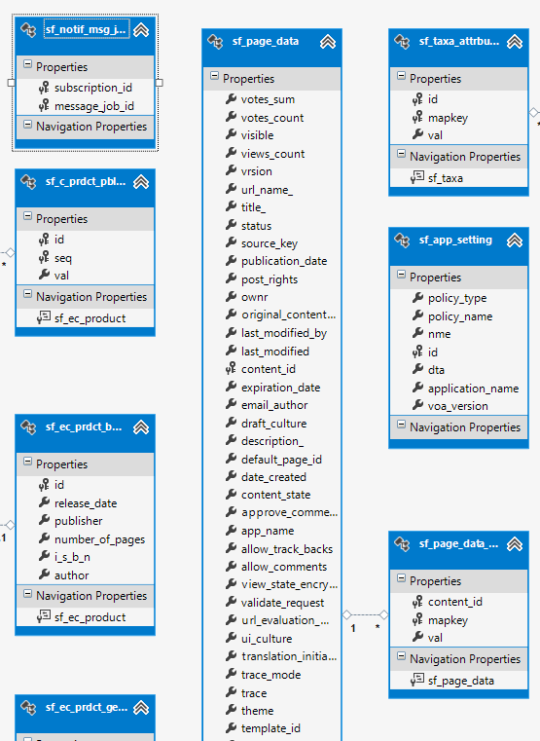
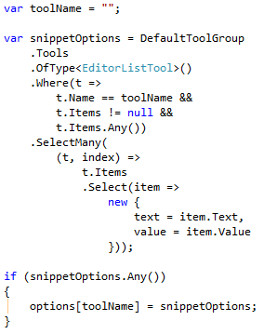
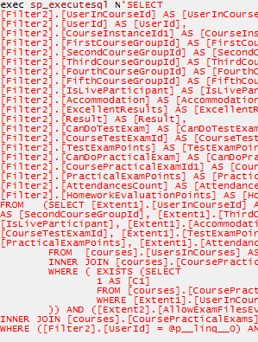
Basic Workflow
Define model
Database
Visual designer
Code
Express & execute query over IQueryable
EF determines & executes SQL query

Slide 12
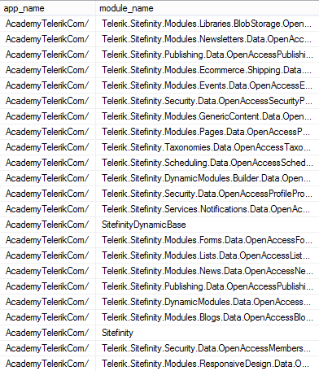
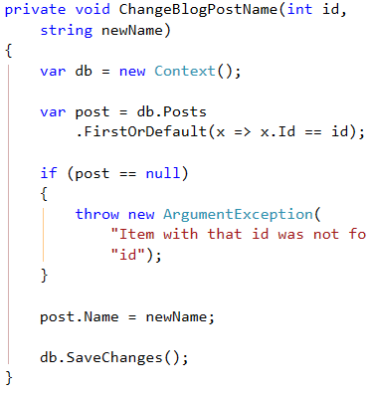
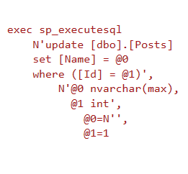
Basic Workflow
EF transforms selected results into .NET objects
Modify data and call “save changes”
EF determines & executes SQL query

Slide 13
EF Components
The DbContext class
DbContext holds the database connection and the entity classes
Provides LINQ-based data access
Implements identity tracking, change tracking, and API for CRUD operations
Entity classes
Each database table is typically mapped to a single entity class (C# class)

Slide 14
Code First Modeling
Define Database with c#

Slide 15
Modeling Workflow
Entity Framework supports three types of modeling workflow:
Database first
Create models as database tables
Use Management Studio or native SQL queries
Model first
Create models using visual EF designer in VS
Code first
Write models and combine them in DbContext

Slide 16
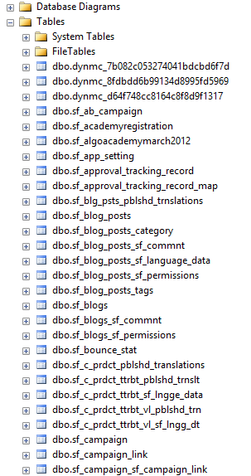
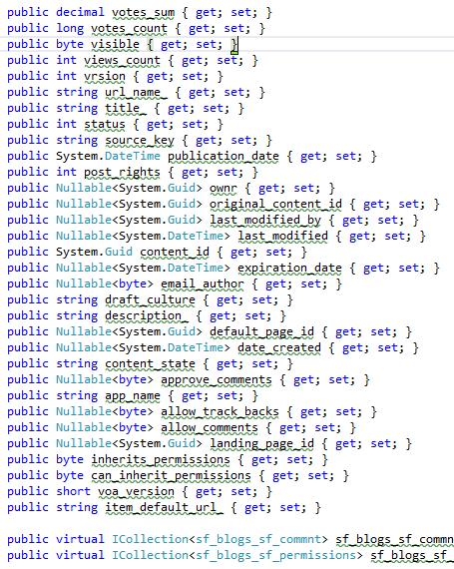
Code First Modeling Workflow
DbContext ModelBuilder
Domain classes
Custom Configuration
As needed

Slide 17
Why Use Code First?
Write code without having to define mappings in XML or create database models
Define objects in POCO
Reuse these models and their attributes
No base classes required
Enables database persistence with no configuration
Can use automatic migrations
Can use Data Annotations (Key, Required, etc.)

Slide 18

Code First Main Parts
Domain classes, DbContext and DbSets

Slide 19
Domain Classes (Models)
Bunch of normal C# classes (POCO)
May contain navigation properties
Recommended to be in a separate class library
Primary key
public class PostAnswer
{
public int PostAnswerId { get; set; }
public string Content { get; set; }
public int PostId { get; set; }
public virtual Post Post { get; set; }
}
Foreign key
Virtual for lazy loading
Navigation property

Slide 20
Domain Classes (Models)
Another example of domain class (model)
public class Post
{
private ICollection<PostAnswer> answers;
public Post()
{
this.answers = new HashSet<PostAnswer>();
}
// ...
public virtual ICollection<PostAnswer> Answers
{
get { return this.answers; }
set { this.answers = value; }
}
public PostType Type { get; set; }
}
Prevents null reference exception
Navigation property
Enumeration

Slide 21

Demo: Models

Slide 22
DbContext Class
A class that inherits from DbContext
Manages model classes using DbSet type
Implements identity tracking, change tracking, and API for CRUD operations
Provides LINQ-based data access
Recommended to be in a separate class library
Don't forget to reference the Entity Framework library (using NuGet package manager)
If you have a lot of models it is recommended to use more than one DbContext

Slide 23
DbSet Type
Collection of single entity type
Set operations: Add, Attach, Remove, Find
Use with DbContext to query database
public DbSet<Post> Posts { get; set; }

Slide 24
DbContext Example
using System.Data.Entity;
using CodeFirst.Models;
public class ForumContext : DbContext
{
public DbSet<Category> Categories { get; set; }
public DbSet<Post> Posts { get; set; }
public DbSet<PostAnswer> PostAnswers { get; set; }
public DbSet<Tag> Tags { get; set; }
}

Slide 25
Demo: DbContext

Slide 26
How to Interact With the Data?
var db = new ForumContext();
var category = new Category { Parent = null, Name = "Database course", };
db.Categories.Add(category);
var post = new Post();
post.Title = "Срока на домашните";
post.Content = "Моля удължете срока на домашните";
post.Type = PostType.Normal;
post.Category = category;
post.Tags.Add(new Tag { Text = "домашни" });
post.Tags.Add(new Tag { Text = "срок" });
db.Posts.Add(post);
db.SaveChanges();

Slide 27
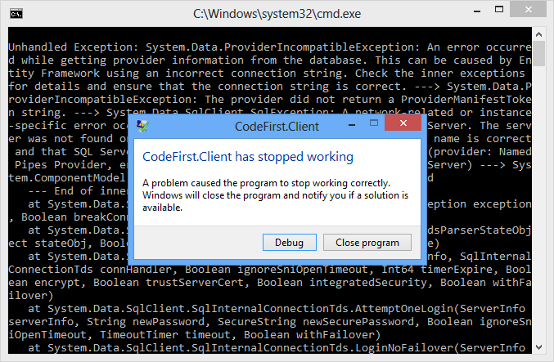
Demo: Using The Data

Slide 28
Where is My Data?
By default app.config file contains link to default local db
Server by default: (localdb)\v11.0 or .\SQLEXPRESS.[full-class-name]
We can use VS server explorer to view database
<entityFramework>
<defaultConnectionFactory type="System.Data.Entity.Infrastructure.LocalDbConnectionFactory, EntityFramework">
<parameters>
<parameter value="v11.0" />
</parameters>
</defaultConnectionFactory>
</entityFramework>

Slide 29
How to Connect to SQL Server?
First, create context constructor that calls base constructor with appropriate connection name
Then add the connection string in app.config
public class ForumContext : DbContext
{
public ForumContext()
: base("ForumDb")
{ } …
}
Server address might be .\SQLEXPRESS
<connectionStrings>
<add name="ForumDb" connectionString="Data Source=.;Initial Catalog=ForumDb;Integrated Security=True" providerName="System.Data.SqlClient" />
</connectionStrings>

Slide 30
Database Connection Workflow
Connection String Available?
Database Exists?
Use Database
Build String (SQL Server Express or Create Local DB)
Create Database

Slide 31
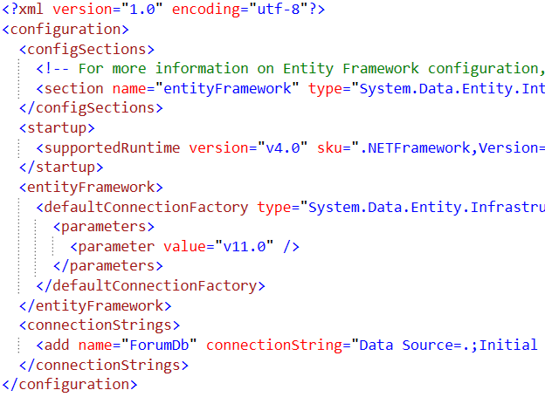
Demo: Database Connection

Slide 32

Using Code First Migrations

Slide 33
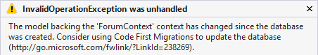
Changes in Domain Classes
What happens when we change our models?
Entity Framework compares our model with the model in __MigrationHistory table
By default Entity Framework only creates the database and don't do any changes after that
Using Code First Migrations we can manage differences between models and database

Slide 34
Code First Migrations
Enable Code First Migrations
Open Package Manager Console
Run Enable-Migrations command
This will create some initial jumpstart code
-EnableAutomaticMigrations for auto migrations
Two types of migrations
Automatic migrations
Set AutomaticMigrationsEnabled = true;
Code-based (providing full control)
Separate C# code file for every migration

Slide 35
Database Migration Strategies
CreateDatabaseIfNotExists (default)
DropCreateDatabaseIfModelChanges
We loose all the data when change the model
DropCreateDatabaseAlways
Great for automated integration testing
MigrateDatabaseToLatestVersion
This option uses our migrations
We can implement IDatabaseInitializer if we want custom migration strategy

Slide 36
Use Code First Migrations
First, enable code first migrations
Second, we need to tell to Entity Framework to use our migrations with code (or app.config)
We can configure automatic migration
Database.SetInitializer( new MigrateDatabaseToLatestVersion
<ForumContext, Configuration>());
This will allow us to delete or change properties
public Configuration()
{
this.AutomaticMigrationsEnabled = true;
this.AutomaticMigrationDataLossAllowed = true;
}

Slide 37
Seeding the Database
During a migration we can seed the database with some data using the Seed method
This method will be run every time (since EF 5)
protected override void Seed(ForumContext context)
{
/* This method will be called after migrating to
the latest version. You can use the
DbSet<T>.AddOrUpdate() helper extension method
to avoid creating duplicate seed data. E.g. */
context.Tags.AddOrUpdate(new Tag { Text = "срок" });
context.Tags.AddOrUpdate(new Tag { Text = "форум" });
}

Slide 38

Demo: Migrations

Slide 39

Configure Mappings
Using Data Annotations and Fluent API

Slide 40

Configure Mappings
Entity Framework respects mapping details from two sources
Data annotation attributes in the models
Can be reused for validation purposes
Fluent API code mapping configuration
By overriding OnModelCreating method
By using custom configuration classes
Use one approach or the other

Slide 41
Data Annotations
There is a bunch of data annotation attributes in System.ComponentModel.DataAnnotations
[Key] – specifies the primary key of the table
For validation: [StringLength], [MaxLength], [MinLength], [Required]
Schema: [Column], [Table], [ComplexType], [ConcurrencyCheck], [Timestamp], [InverseProperty], [ForeignKey], [DatabaseGenerated], [NotMapped]
In EF 6 you can add custom attributes by using custom conventions

Slide 42
Fluent API for Mappings
By overriding OnModelCreating method in DbContext class we can specify mapping configurations
protected override void OnModelCreating(DbModelBuilder modelBuilder)
{
modelBuilder.Entity<Tag>().HasKey(x => x.TagId);
modelBuilder.Entity<Tag>().Property(x => x.Text).IsUnicode(true);
modelBuilder.Entity<Tag>().Property(x => x.Text).HasMaxLength(255);
// modelBuilder.Entity<Tag>().Property(x => x.Text).IsFixedLength();
base.OnModelCreating(modelBuilder);
}

Slide 43
Fluent API Configurations
.Entity()
Map: Table Name, Schema
Inheritance Hierarchies, Complex Types
Entity -> Multiple Tables
Table -> Multiple Entities
Specify Key (including Composite Keys)
.Property()
Attributes (and Validation)
Map: Column Name, Type, Order
Relationships
Concurrency

Slide 44

Demo: Mappings

Slide 45



LINQ and Query Keywords
LINQ

Slide 46
LINQ Extension Methods
Where()
Searches by given condition
First()/FirstOrDefault()
Gets the first matched element
Last()/LastOrDefault()
Gets the last matched element
Select()/Cast()
Makes projection (conversion) to another type
OrderBy()/ThenBy()/OrderByDescending()
Orders a collection

Slide 47
LINQ Extension Methods
Any()
Checks if any element matches a condition
All()
Checks if all element matches a condition
ToArray()/ToList()/AsEnumerable()
Converts the collection type
Reverse()
Reverses a collection
Include()
Includes another collection into the query

Slide 48
LINQ Extension Methods
Average()
Calculates the average value of a collection
Count()
Counts the elements in a collection
Max()
Determines the maximum value in a collection
Sum()
Determines the maximum value in a collection

Slide 49
Demo: LINQ Basics

Slide 50


Reading Data
Making queries

Slide 51
Reading Data with LINQ Query
We can use extension methods (fluent API) for constructing the query
Find element by id
This is called
projection
var customerPhoness = context.Customers
.Select(c => c.Phone)
.Where(c => c.City == "London")
.ToList();
ToList() method executes the query
var customer = context.Customers.Find(2);
Console.WriteLine(customer.ContactTitle);

Slide 52



Demo: Retrieving Data

Slide 53


Create, Update, Delete
The real deal of databases

Slide 54
Creating New Data
To create a new database row use the method Add(…)
SaveChanges() method call is required to post the SQL commands to the database
// Create new order object
Order order = new Order()
{
OrderDate = DateTime.Now, ShipName = "Titanic",
ShippedDate = new DateTime(1912, 4, 15),
ShipCity = "Bottom Of The Ocean"
};
// Mark the object for inserting
context.Orders.Add(order);
context.SaveChanges();
This will execute an SQL INSERT

Slide 55
Cascading Inserts
We can also add cascading entities to the database:
This way we don't have to add each City individually
They will be added when the Country entity (Spain) is inserted to the database
Country spain = new Country();
spain.Name = "Spain";
spain.Population = "46 030 10";
spain.Cities.Add(new City { Name = "Barcelona"} );
spain.Cities.Add(new City { Name = "Madrid"} );
countryEntities.Countries.Add(spain);
countryEntities.SaveChanges();

Slide 56
Updating Existing Data
DbContext allows modifying entity properties and persisting them in the database
Just load an entity, modify it and call SaveChanges()
The DbContext automatically tracks all changes made on its entity objects
Order order = northwindEntities.Orders.First();
order.OrderDate = DateTime.Now;
context.SaveChanges();
This will execute an SQL UPDATE
This will execute an SQL SELECT to load the first order

Slide 57
Deleting Existing Data
Delete is done by Remove() on the specified entity collection
SaveChanges() method performs the delete action in the database
Order order = northwindEntities.Orders.First();
// Mark the entity for deleting on the next save
northwindEntities.Orders.Remove(order);
northwindEntities.SaveChanges();
This will execute an SQL DELETE command

Slide 58


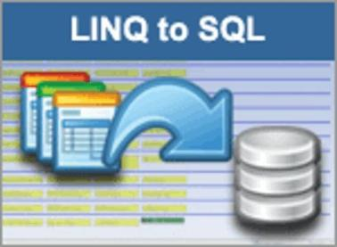


Demo: CRUD Operations

Slide 59
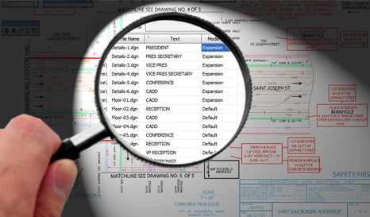
Performance Issues
What is the N+1 Query Problem and How to Avoid It?

Slide 60
The N+1 Query Problem
What is the N+1 Query Problem?
Imagine a database that contains tables Products, Suppliers and Categories
Each product has a supplier and a category
We want to print each Product along with its Supplier and Category:
foreach (var product in context.Products)
{
Console.WriteLine("Product: {0}; {1}; {2}",
product.ProductName, product.Supplier.CompanyName,
product.Category.CategoryName);
}

Slide 61
The N+1 Query Problem
This code will execute N+1 SQL queries:
Imagine we have 100 products in the database
That's ~ 201 SQL queries → very slow!
We could do the same with a single SQL query
One query to retrive the products
foreach (var product in context.Products)
{
Console.WriteLine("Product: {0}; {1}; {2}",
product.ProductName, product.Supplier.CompanyName,
product.Category.CategoryName);
}
Additional N queries to retrieve the supplier for each product
Additional N queries to retrieve the category for each product

Slide 62
Solution to the N+1 Query Problem
Fortunately there is an easy way in EF to avoid the N+1 query problem:
Using Include(…) method only one SQL query with join is made to get the related entities
foreach (var product in context.Products.
Include("Supplier").Include("Category"))
{
Console.WriteLine("Product: {0}; {1}; {2}",
product.ProductName, product.Supplier.CompanyName,
product.Category.CategoryName);
}
No additional SQL queries are made here for the related entities

Slide 63
Incorrect Use of ToList()
In EF invoking ToList() executes the underlying SQL query in the database
Transforms IQueryable<T> to List<T>
Invoke ToList() as late as possible, after all filtering, joins and groupings
Avoid such code:
This will cause all order details to come from the database and to be filtered later in the memory
List<OrderDetail> orderItemsFromTokyo =
entities.Order_Details.ToList().
Where(od => od.Product.Supplier.City == "Tokyo").ToList();

Slide 64

Attaching and Detaching Objects

Slide 65
Attaching and Detaching Objects
In Entity Framework, objects can be attached to or detached from an object context
Attached objects are tracked and managed by the DbContext
SaveChanges() persists all changes in DB
Detached objects are not referenced by the DbContext
Behave like a normal objects, like all others, which are not related to EF

Slide 66
Attaching Detached Objects
When a query is executed inside an DbContext, the returned objects are automatically attached to it
When a context is destroyed, all objects in it are automatically detached
E.g. in Web applications between the requests
You might later on attach to a new context objects that have been previously detached

Slide 67
Detaching Objects
When an object is detached?
When we obtain the object from an DbContext and then Dispose it
Manually: by calling Detach(…) method
Product GetProduct(int id)
{
using (Entities entities =
new Entities())
{
return entities.Products.First(
p => p.ProductID == id);
}
}
Now the returned product is detached

Slide 68
Attaching Objects
When we want to update a detached object we need to reattach it and the update it
Done by the Attach(…) method of the context
void UpdatePrice(Product product, decimal newPrice)
{
using (Entities entities =
new Entities())
{
northwindEntities.Products.Attach(product);
product.UnitPrice = newPrice;
northwindEntities.SaveChanges();
}
}

Slide 69


Demo: Attaching and Detaching Objects

Slide 70
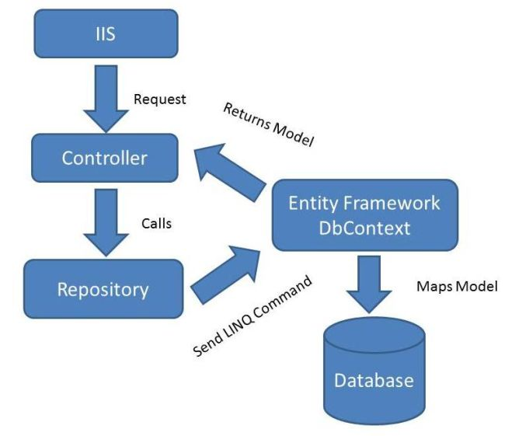
Repository Pattern

Slide 71
Repository Pattern
Gives abstraction over the data layer
Single place to make changes to your data access
Single place responsible for a set of tables
Easily replaceable by other implementations
Hides the details in accessing data
Can be implemented in various ways

Slide 72


Demo: Repository Pattern

Slide 73
QUESTIONS?

Slide 74
Live Demo
Using c0de first approach, create database for student system with the following tables:
Students (with Id, Name, Number, etc.)
Courses (Name, Description, Materials, etc.)
StudentsInCourses (many-to-many relationship)
Homework (one-to-many relationship with students and courses), fields: Content, TimeSent
Annotate the data models with the appropriate attributes and enable code first migrations
Write a console application that uses the data
Seed the data with random values

